Slide 1


Investigation of defect structures in metal oxides via spectroscopic techniques
Mert DİL
İrem ENGİNAR
Buse BOLATTEKİN
Adele BİZHANOVA
Name of the Supervisor: Emre ERDEM

Slide 2

Why ZnO is so important?
Future material instead of silicon
ZnO is n -type semiconductor
Direct and wide bandgap semiconductor material
The fabrication of high quality single crystals and epitaxial layers
Used in ZnO-based electronic and optoelectronic devices
Advantages: large exciton binding energy, the ability to grow single crystal substrates, wet chemical etching, low power threshold for optical pumping, radiation hardness and biocompatibility

Slide 3
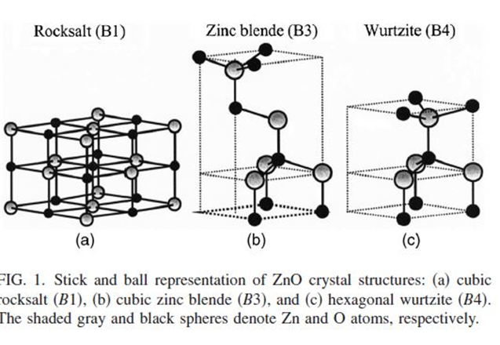

What is ZnO compound?
1. Crystal structure
Wurtzite(B4), zinc blende (B3) and rocksalt (B1)
Stable forms:
Rocksalt structure at high pressures
Zinc-blende on cubic structures
Wurtzite at ambient conditions

Slide 4
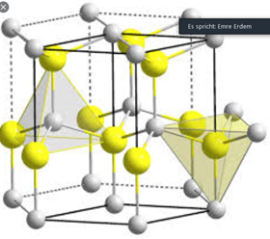
Wurtzite structure
Hexagonal lattice symmetry is characterized by two interconnecting sublattices of Zn and O
Rises to polar symmetry along the hexagonal axis.
This polarity is responsible for a number of the properties of ZnO (including its piezoelectricity and spontaneous polarization)
ZnO is a common indicator covalent bonding (with sp^3)
The Zn–O bond possesses very strong ionic character(with an ionicity of fi 0.616 on the Phillips ionicity scale)
On the border line between being classed as a covalent and ionic compound

Slide 5
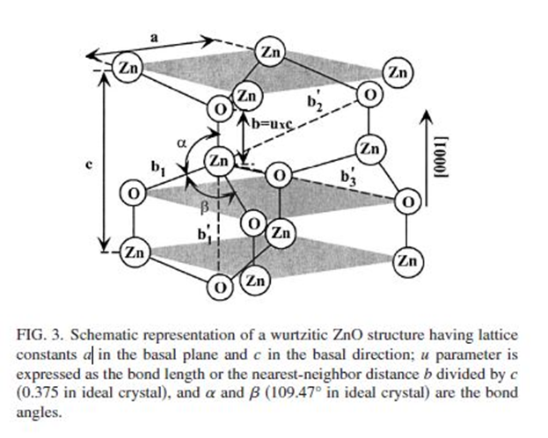
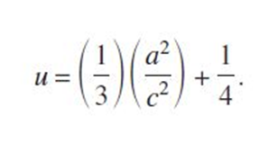
2. Lattice parameters
a,c,u,c/a ratio
Depends on:
Free-electron concentration acting via deformation potential
Concentration of foreign atoms, defects and their difference of ionic radii
External strains
Temperature
Accurately measured by highresolution x-ray diffraction (HRXRD) for a set of symmetrical and asymmetrical reflections

Slide 6
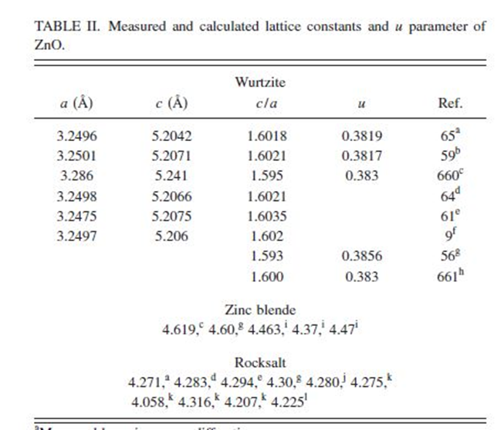
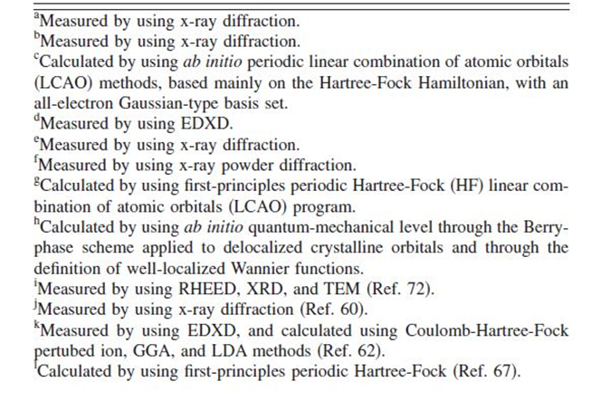

Slide 7
DEFECTS
Zinc Vacancies (V_{Zn}) : are double acceptors.
Oxygen Vacancies (V_{O}) : O vacancy is a deep-negative U donor, where the +1 charge state is thermodynamically unstable. The g value of O vacancy is 1.995.
Zinc Interstitials(Zn_{i}): are shallow donor. Its the electron configuration configuration end with 4s² which shows that it is diamagnetic. Its g factor is 1.96
Oxygen Interstitial : have been suggested to form several configurations, such as dumbbell or split interstitials. Its electron configuration ends with 2p⁴, 2p⁵, and 2p⁶, giving O_{i},O_{i}⁻,O_{i}⁻² respectively.

Slide 8
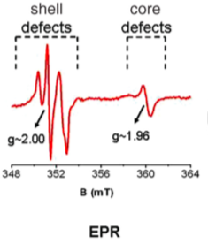
Zn_{i} can not detect by EPR due to its diamagnetic nature.
O_{i}²⁻ is diamagnetic. That’s why, it can not be detect by EPR.
O_{i}⁻ is paramagnetic so it can detect by EPR.
V_{o} can find with EPR.

Slide 9
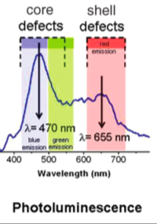

Slide 10
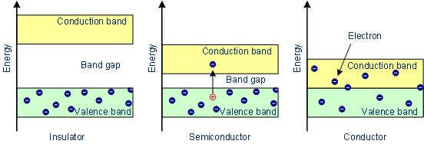
Semiconductor Properties of ZnO
What is mean by band gap?
In graphs of the electronic band structure of solids, the band gap generally refers to the energy difference (in electron volts) between the top of the valence band and the bottom of the conduction band in insulators and semiconductors.

Slide 11
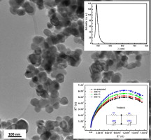
Electrical and Optical Properties of ZnO
ZnO is a semiconductor material with direct wide-bandgap Eg = 3.4 eV at 300K°
The corresponding electron Hall mobility at 300K for low n-type conductivity is 200 cm^2/v.s
It’s hole mobility is 5–50cm^2/ V.s.
Dielectric Constant of ZnO is 8.66 F/m
Activation energy of ZnO is 60 meV
It absorbs UV light below 375.75 A°

Slide 12
Experimental EPR spectra measured by teacher Emre Erdem

Slide 13

Plotting EPR spectra by MATLAB

Slide 14
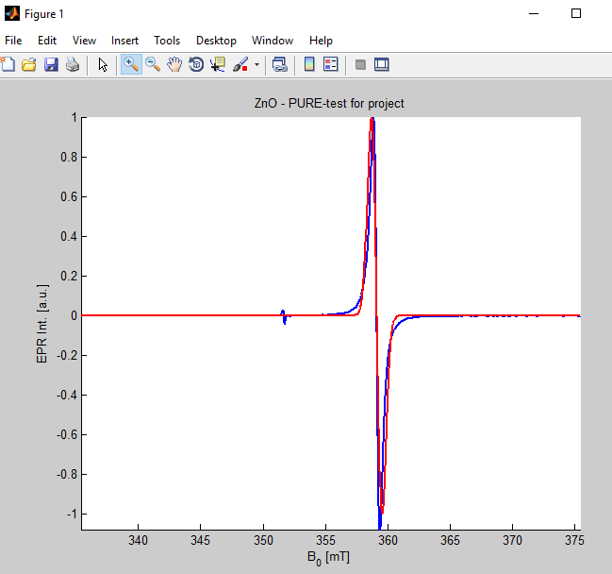

Following Matlab code was used for simulating the EPR spectra
The Experimental and Simulated EPR Spectra of ZnO in MATLAB
EXP
SIM

Slide 15
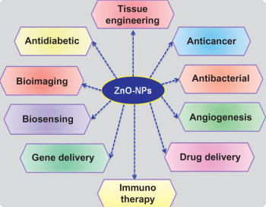

ZnO applications
- Luminescent properties
Low-cost
Low-toxicity
Biocompatibility
High Catalytic Efficiency
Strong Adsorption Capability
High Isoelectric Point

Slide 16
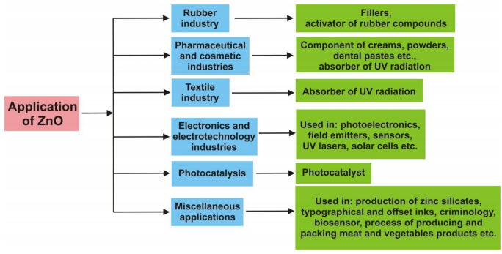
Schematic representation all the application of ZnO
Rubber Industry
Global production of zinc oxide amounts to about 105 tons per year
The thermal conductivity of typical pure silicone rubber is relatively low; however, it can be improved by adding certain thermal conductivity fillers, including metal powders, metal oxides and inorganic particles.

Slide 17
Textile industry: offers a vast potential for the commercialization of nanotechnological products. In particular, water repellent and self-cleaning textiles.
The Pharmaceutical and Cosmetic Industries: Due to its antibacterial, disinfecting and drying properties ZnO is widely used in the production medicines for instance, for epilepsy, and later for diarrhea.
The Electronics and Electro-technology Industries: ZnO also exhibits the phenomenon of luminescence (chiefly photoluminescence—emission of light under exposure to electromagnetic radiation). Zno is more resistant to UV rays, and also has higher electrical conductivity
Photo-catalysis: The most commonly used catalysts are TiO2 and ZnO. ZnO provides similar or superior activity to that of TiO2, but is less stable and less sensitive to photo corrosion
Miscellaneous Applications: The addition of zinc oxide improves the process time and the resistance of concrete to the action of water. the addition of ZnO to Portland cement slows down hardening and quenching (it reduces the gradual evolution of heat), and also improves the whiteness and final strength of the cement.

